Slide 1
Multithreading
Notes:
1
1

Slide 2

Table of Content
Objective
Multitasking
Threads
Process
Thread Implementation
Daemon Thread
Life Cycle And Thread State
Sleeping, Joining & Interrupting Threads
Race Condition
Synchronization
Monitors & Structured Locking
Volatile Keyword
Next

Slide 3
Multitasking
A process is an instance of a program running inside a computer.
A process has a self-contained execution environment.
Each process has it own memory space.
During process creation, it needs more resources than a thread.
Cost of communication between the process is high.
A process contains one or more different threads.
Multitasking
Multitasking is the ability to run multiple application programs concurrently.
In Multitasking the operating system can switch between tasks by resuming the task from the suspended state.
A thread is a lightweight sub process.
A thread also is a self contained execution environment.
Thread shares the common memory space of the process in which they are contained.
Thread requires fewer resources than creating a new process.
Cost of communication between the thread is low.
A thread always resides under a process.
Multiprocessing
Multithreading
Next

Slide 4
What is a Thread?
Single Sequential flow of control
Sequence of Programmed instruction that can be managed independently
Allows the program to split into simultaneously running tasks
Threading is a technique that allows multiple activities to coexist within a single program.
Each Activity that can run concurrently within a program is referred to as a thread.
One process one thread
One process multiple threads
Next

Slide 5
Thread in Java
Every java program uses at least one thread called the main thread
Upon execution of a java program, JVM creates a main thread and executes the main() within that thread.
Java Programs like AWT, Swing, Applets, Servlets, RMI, EJB etc use the concept of threads.
Threads help us do the following in an easier an elegant way.
Make the User Interface more responsive
Simplify Modeling
Perform Asynchronous and background Processing
Back
Next

Slide 6

Thread in Java (Continued)
Make the User Interface more responsive
Applet responds to user events at the same time draws random shapes on the display
Modularize the composite task
The timer that displays the last updated time of a document can be put in a thread instead of having the main() to do it in a loop. This helps the main thread to focus on other important tasks to be done.
Perform Asynchronous and background Processing
Word processor has to format the user text at the same time spell check the contents. The spell checker can be put in a thread that does the spell check at the background rather than the main thread doing it by intervening the format job and make the user wait till spell check is complete.
Back
Next

Slide 7
A Java Application
1
A single process (JVM)
2
Consists of various threads
3
Application thread – responsible for running the main method
4
Other threads for runtime concern – like garbage collection
Next
Xoriant Solution Pvt. Ltd.

Slide 8
Different ways of creating a Thread
Thread Creation
Extending java.lang.Thread class
Implementing java.lang.Runnable interface
Difference between Thread & Runnable
Next

Slide 9
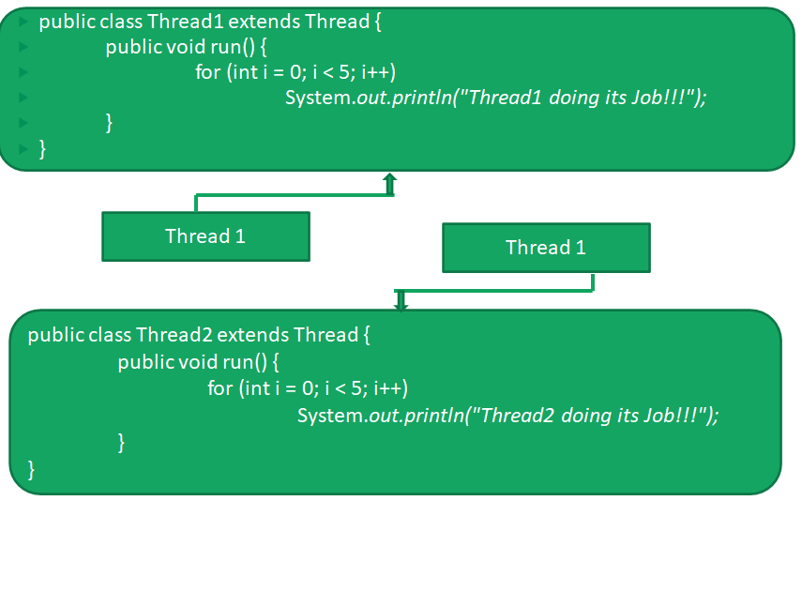
Using Thread class
Next

Slide 10
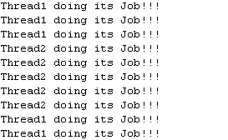
Thread Execution
public class ThreadExecutor {
public static void main(String[] args) {
Thread1 t1=new Thread1();
Thread2 t2=new Thread2();
t1.start();
t2.start();
}
}
Order of output is non-deterministic in a thread program
Back

Slide 11
Using Runnable Interface
public class MyThread implements Runnable {
public void run(){
System.out.println(“Thread Runs!!!”);
}
public static void main(String[] args) {
MyThread myThread=new MyThread();
Thread1 t1=new Thread1(myThread);
Thread2 t2=new Thread2(myThread);
t1.start();
t2.start();
}
}
Order of output is non-deterministic in a thread program
Thread Runs!!!
Thread Runs!!!
Next

Slide 12
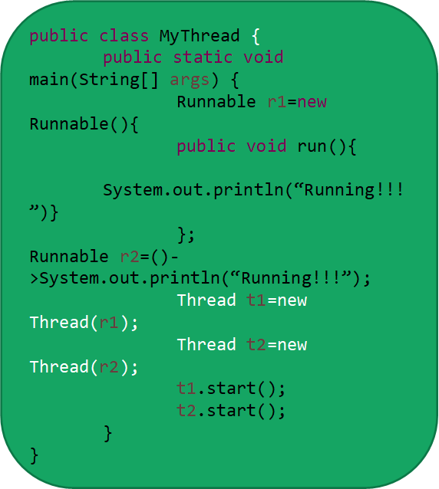
Alternative Syntax
Order of output is non-deterministic in a thread program
Running!!!
Running!!!
Back

Slide 13
Difference between Thread & Runnable
Thread
Extending Thread class enforces is-a-type of relationship making the class Thread1 itself as a Thread.
Thread1 is a type of Thread that should be more focused towards threading related tasks
Runnable
Implementing Runnable interface enforces Thread2 to bind to a contract that Thread2 should also work like thread.
Purpose of the Thread2 class can be different apart from that it should also behave like thread

Slide 14


Time for Case Study

Slide 15
Case Study-1
Calculate the nth Prime Number as per the user input using thread program?
Answer:
Get the user input for n
Calculate the nth prime number
Repeat
Quit when user input (n) is zero
Make this program run in parallel
Next

Slide 16
Case Study-2
When does a Java application ends?
Answer: When all the user threads have exited.
What if you want the application to exit, not to wait for a thread to complete?
Answer: The answer is Daemon thread. Daemon is a thread which will automatically be killed once the main thread ends.
Creation of Daemon thread syntax is:
Answer: Thread t=new Thread(r);
t.setDaemon(true);
t.start();
Demon Thread
Next

Slide 17
Case Study-2 (Continued)
Check out the Prime number program by making the threads as Daemon thread?
Syntax

Slide 18
Time for Case Study
Thread Attributes
Next

Slide 19
Thread Attributes
Aspects of Threading
1
Thread Body
2
Thread Priority
Thread State
3
Next
Xoriant Solution Pvt. Ltd.

Slide 20
Thread Body
The core part of the thread is the Thread body that is defined via the run() method
All actions the thread is expected to do has to be provided in the run() method
The thread body can be defined in 2 ways
Extending Thread class and override the Thread’s run() method
Implementing the Runnable interface and implementing the run() method

Slide 21
Thread Priority
Multiple thread executing on a single CPU in an order is called as Scheduling.
Java runtime system schedules a thread to run based on its priority.
A java thread acquires the priority of a thread from the thread that created it although we can modify this priority any time after creation.
Thread priorities range from low to high as indicated by MIN_PRIORITY-1 and MAX_PRIORITY-10 (public static final constants declared in Thread class).Higher the priority, greater the chance for it to run.
Next

Slide 22
Thread Priority(continued)
We can access and modify the thread priorities by getPriority() and setPriority(int) methods in Thread class
A thread runs until
A higher priority thread becomes Runnable
Running thread issues a yield method() or its run() is complete
On time-slicing systems, the time allotted for that thread expires
The thread scheduler in certain situations can choose lower priority thread over a higher priority thread for execution(e.g to avoid starvation).Therefore program logic should not rely on thread priority.
Back

Slide 23
Thread State
A java thread can be possibly in any one of the following states during its life time
Thread put in queue and is ready to run
Thread Object created
New
New
start()
Runnable
stop(), run()
Complete
sleep() expired,
join() completed,
IO completed,
acquired lock
stop()
sleep(), join(),
IO, request lock
Thread is eligible to be garbage collected
Dead
Blocked
Thread has to get into runnable state to continue its execution

Slide 24
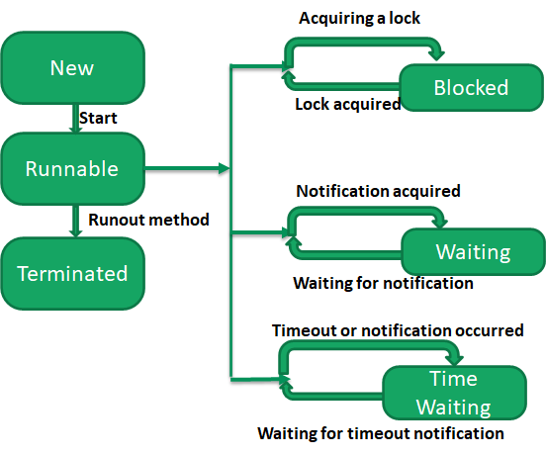
Logical Thread State
New
Runnable
Blocked
Waiting
Timed Waiting
Terminated
Back
Notes:
New is new Thread(r)
Runnable when thread.start() (Not exactly running as it is waiting for the OS schedule)
Blocked in case of synchronization
Waiting in case it is waiting for the notification (Ex: Join)
Timed Waiting is basically waiting for the defined time (Ex: Sleep)
Terminated When the thread ends or exits

Slide 25
Time for Case Study

Slide 26
Case Study-3
Let’s add some code to the existing prime number application to track all the threads and their states
Answer: Steps for the solution
Create number of threads and add them to a Array List
Create a print method to print each thread state for every 5 sec Interval.
How to make a Thread to pause for 5 sec? Ans: Use of Sleep method.
Let’s check out the states in the code
Sleep Method
Next

Slide 27
Use of Sleep Method
Sleep is a static method is present in Thread.class which allows us to pause the thread for a specified millisecond before it resumes back.
Sleep Syntax
Thread.sleep(long milliseconds)
Thread.sleep(long milliseconds, int nanos)

Slide 28
Case Study -4
What if we need to wait to print the message after all the threads end? Means we don’t know how much time? Hence can’t use sleep which takes specified time.
Refer to the example code:
Answer: “Join” is the solution, on which thread “the join” is called the other threads have to wait until it completes its execution.
Join Method
Next

Slide 29
Use of Join Method
Note: Join with a millisecond represents the stipulated time with in which the thread should die. Default is join(0)
Join Syntax
thread.join()
thread.join(long millisecond)
thread.join(long millisecond, int nanos)

Slide 30
Case Study - 5
What if we need to stop a running thread?
Refer to the example code:
Answer:
By making a thread as Daemon, so what happens once the main thread ends this thread automatically ends
By invoking stop() which is deprecated from java1.2 and not in use now
By calling interrupt() method on a thread
Interrupt Method
Next
Notes:
The various ways to interrupt a thread
By making a thread as Daemon, so what happens once the main thread ends this thread automatically ends
By invoking stop() which is deprecated from java1.2 and not in use now
By calling interrupt() method on a thread
We can use the same example, but we have to make the reportedThred as non-Daemon

Slide 31
Use of Interrupt()
What if we need to stop a running thread?
Refer to the example code:
Syntax
Thread.interrupt()
It smoothly stop the thread and intimate with the help of an interrupted exception.
If (Thread.interrupt()) {
throw new InterruptedException();
}
Notes:
The various ways to interrupt a thread
By making a thread as Daemon, so what happens once the main thread ends this thread automatically ends
By invoking stop() which is deprecated from java1.2 and not in use now
By calling interrupt() method on a thread
We can use the same example, but we have to make the reportedThred as non-Daemon

Slide 32
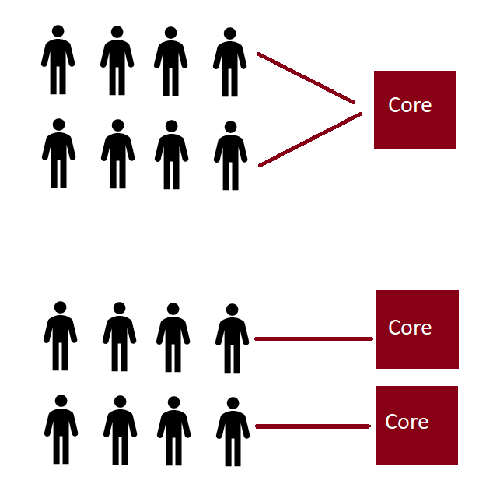
Parallelism Vs Concurrent
Concurrent is when 10 threads needs to be executed in 1 core
Concurrent
Parallelism is when 2 threads needs to be executed in 2 cores
Parallelism
Next
Notes:
Parallelism is when 2 threads needs to be executed in 2 cores
Concurrent is when 10 threads needs to be executed in 1 core

Slide 33
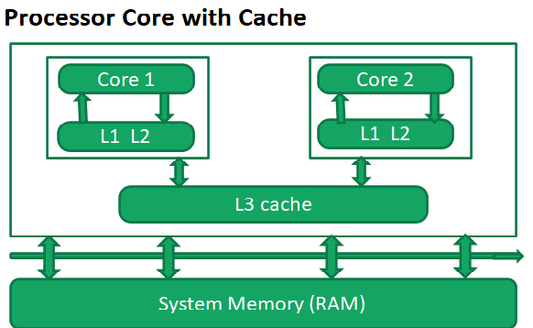

Race Condition
Why?
System Bus
Race Condition Patterns
Check-then-act
Read-modify-write
Next
Notes:
Check-then-write
If(value==0){
System.out.println(value+1);
}
Read-modify-write
Value++

Slide 34
Solution to Race Condition
Use of Synchronized block/statement
synchronized(objectRef){
//code here
}
Use of synchronized method
public synchronized void methodA(){
//code here
}
Lock and Key Model
Use of Lock Interface
Lock l = new ReetrantLock();
public void run(){
l.lock();
try {
//Code here
}finally{
l.release();
}
}
More..
Use of Semaphore
Semaphore s = new Semaphore(3);
public void run(){
s.acquire();
try {
//Code here
}finally{
l.release();
}
}
More..
Synchronized
Semaphore
Lock
Next

Slide 35
ReentrantLock
ReentrantLock
Extends functionality of synchronization keyword.
It is added in Java 1.5.
Provides more control on lock acquisition.
Next

Slide 36

Why ReentrantLock?
Synchronized does not have fairness supported. ReentrantLock has support for fairness. It means we can specify that longest waiting thread will get the preference.
Reentrant lock has tryLock() & tryLock(time) methods which checks weather the lock is available or not.
ReentrantLock can provide us the list of the threads waiting for the lock.
Refer to the example code:
Back
Next

Slide 37

Limitations of ReentrantLock
At a time only one thread can avail the lock to execute the critical section.
Need to wrap the method body inside try/finally blocks which makes code unreadable & hides business logic.
It is developer's responsibility to acquiring & releasing the lock. If we forget to release the lock then it leads to major bug difficult to analyse.
Back

Slide 38
Semaphores
Semaphores are often used to restrict the number of threads that can access a resource at a time unlike use lock which will restrict to only one thread at a time.
Semaphore is a class in java.util.concurrent package. Semaphore maintains a set of permits it is initialized with.
Permits are nothing but a count indicating the maximum number of threads that can access a particular resource
Semaphore has 2 methods
acquire()
The thread calling the acquire() method will obtain a permit to access a resource, till the maximum number of permits are exhausted
release()
Thread calling the release() will release the permit for that resource, so that other threads in the queue can issue the accquire() call and get the permit
Next

Slide 39
Semaphores
Semaphores are normally used to guard a critical section of code. Therefore, the thread acquiring the lock has to release it
Refer to the example code:
Semaphore semaphore = new Semaphore(3);
semaphore.acquire();
//access critical section of code
semaphore.release();
Back

Slide 40
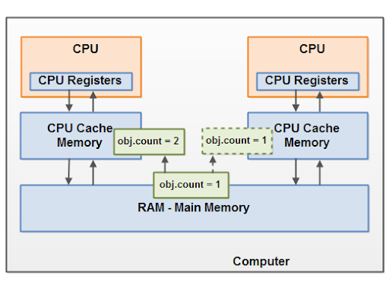
Use of Volatile
Volatile is a keyword used before a variable
Used to resolve the visibility issue by allowing the threads not to read/write the data to cache rather to the main memory (RAM)
If the requirement is only to resolve the visibility issue, then use of synchronization is not an optimal solution as it will hit the performance of the application.
Diagram
Next

